Slide 1
Financial Literacy
Empowering the Next Generation with Smart Money Habits
Team 2
Bharath Mahavadi
Ravi Gunturu
Atul Agrawal
Pranav Ratnaparkhi
Rajesh Yadav
Maruthi Prasad Chitti

Slide 2
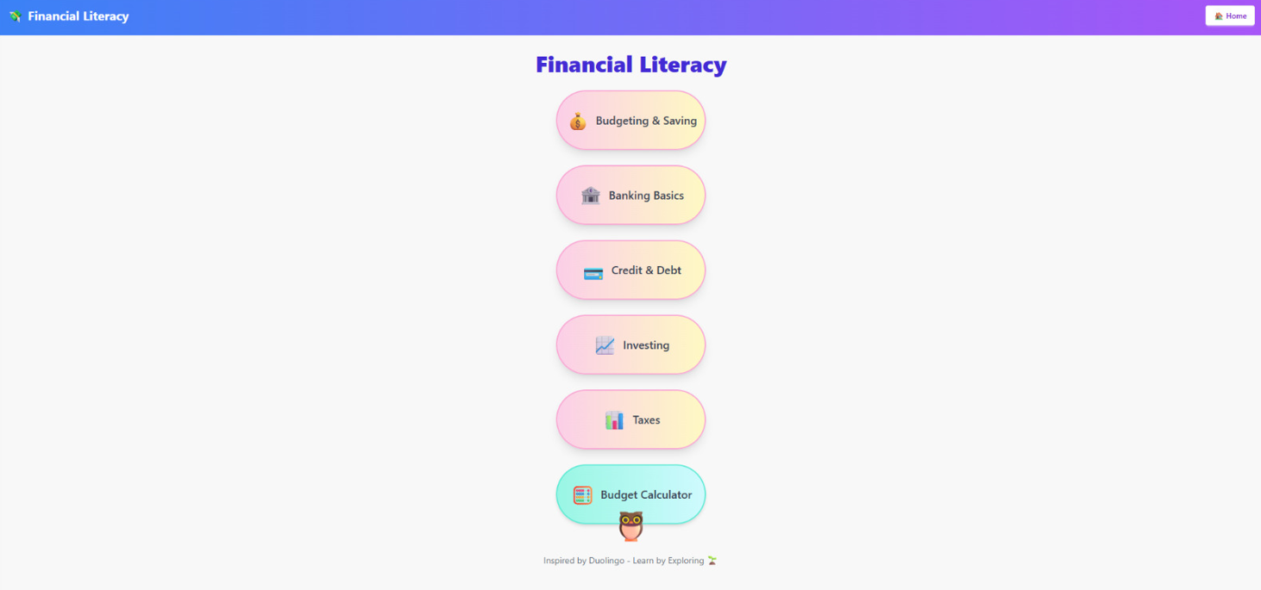
Vision Statement:
To empower children and young learners with essential financial knowledge and habits through an engaging, interactive, and accessible mobile app shaping a financially responsible and confident generation for the future.

Slide 3


Problem Statement:
Many of the Young in this generation lack basic understanding of personal finance, leading to poor money management in adulthood.
Traditional education often misses essential topics like savings, budgeting and investing.
To bridge this gap, an engaging age-appropriate mobile app will help in learning about money fun and accessible.
Target Audience:
This project aims to empower students and educators with the knowledge and skills to make smart financial decisions.
It promotes economic empowerment, and nurture a financially aware generation ready to contribute positively to society.

Slide 4
Solution Overview:
This mobile app delivers interactive, gamified, and curriculum-aligned financial literacy education for students and teachers, designed to be accessible, multilingual, and scalable for schools
Key Features:
Gamified Lessons: Budgeting tool.
Interactive Simulations: money management games
Progress Tracking: visual dashboard showing persona growth and rewards
Quiz & Rewards: Learning through points, badges and challenges.

Slide 5
Technical Overview:
Platform: Platform independent
Multilingual Support: English + regional Indian languages.
Secure & Compliant: Follows child data protection and privacy norms
Tech Stack:
Reactjs
NGROK
Swiftchat platform

